Slide 1


Enhancing Sign Language Recognition: A Computationally Efficient and Interpretable Multi-Modal Approach
Authors: Chingiz Tursunbaev, Mukhiddin Toshpulatov, Nirmal Adhikari, Wookey Lee
Voice AI Research Center, Inha University, South Korea
Presenter: [Chingiz Tursunbaev] {chingiz2503@inha.edu}
Notes:
Hello everyone. My name is Chingiz Tursunbaev from the Voice AI Research Center at Inha University.
Today, I am presenting our latest research titled 'Enhancing Sign Language Recognition.' We are proposing a new multi-modal approach that is not only interpretable but also computationally efficient enough for real-world use.

Slide 2

The "Robustness-Efficiency" Gap
The Conflict:
Modern SLR systems face a dichotomy: Accuracy vs. Speed.
High-Performance Models: Rely on heavy Optical Flow or massive Graph Neural Networks (GNNs).
The Cost: Prohibitive computational costs and "black-box" complexity.
The Real-World Issue:
Latency is critical for deployment.
Standard RGB models fail during rapid gestures or hand occlusions.
Notes:
To understand why we did this research, we first need to look at the current problem in the field, which we call the 'Robustness-Efficiency' Gap.
Right now, Sign Language Recognition systems face a conflict. If you want high accuracy, you usually have to use heavy models that rely on Optical Flow or massive Graph Neural Networks. These are accurate, but they are 'black boxes' and far too slow for real-time applications.
On the other hand, if you try to make these models faster, they often fail when it matters most—like when a signer moves their hands very quickly or when hands are occluded. Our goal was to solve this trade-off: to build a system that is robust against rapid motion but light enough to run efficiently.

Slide 3
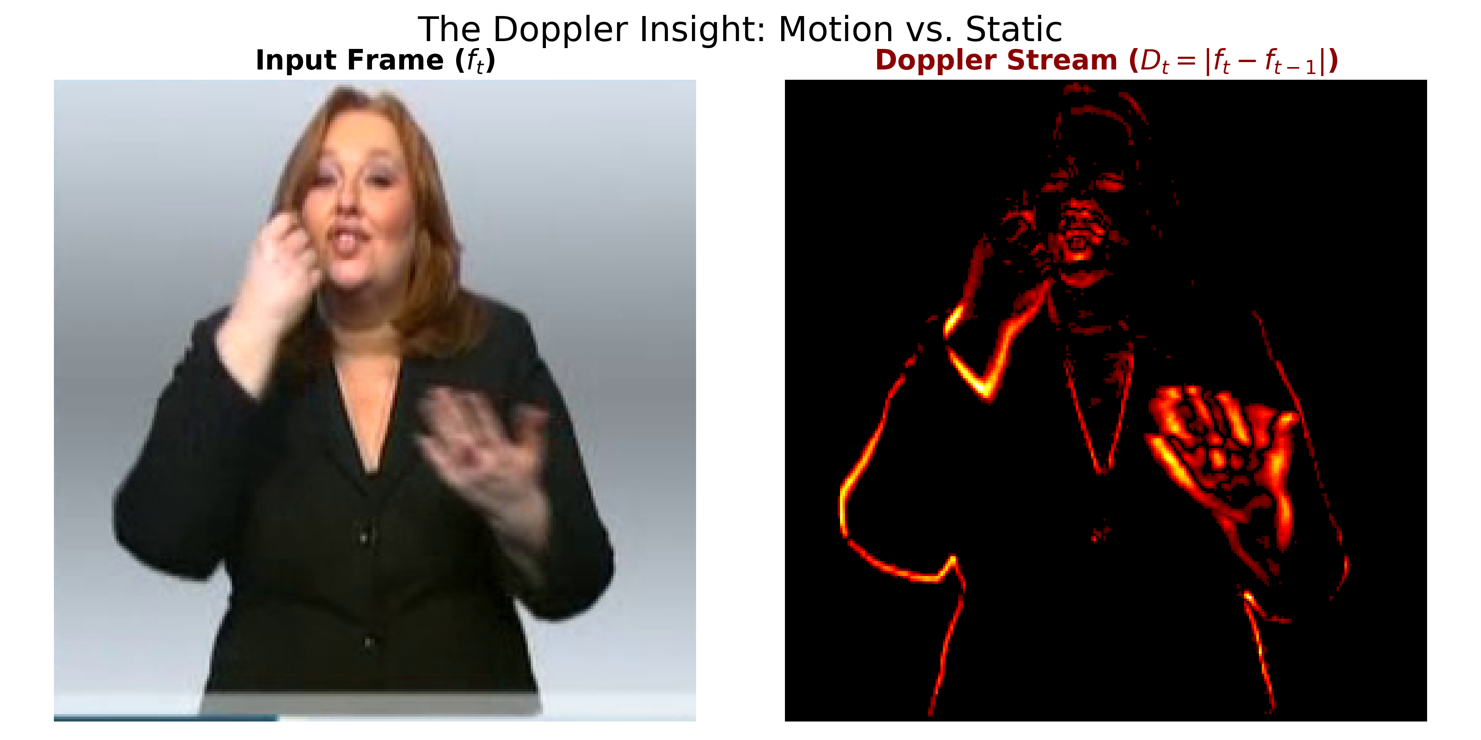
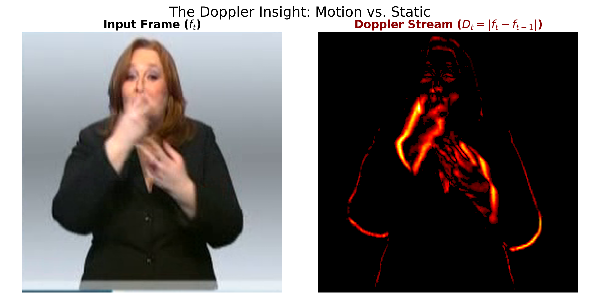
Our Solution – The Doppler-Enhanced Approach
Core Concept: A "Doppler Motion Stream".
The Insight:
Instead of complex flow estimation, we use a lightweight "Doppler" analog.
Frame Differencing: D_{t} = f_{t} – f_{t-1}
Why it Works:
Noise Suppression: Static backgrounds (D_{t} ≈ 0) naturally disappear.
Edge Enhancement: Rapid movements create strong difference boundaries, sketching the hand's trajectory.
Notes:
"So, to solve this trade-off between speed and accuracy, we introduced our core contribution: the Doppler Motion Stream.
We drew inspiration from physics. In the real world, the Doppler effect uses frequency shifts to detect motion. In our computer vision approach, we use Frame Differencing as a computational analog.
The math is incredibly simple, as you can see in the equation here. We just take the absolute difference between the current frame and the previous one.
This simple operation does two powerful things for us: First, it suppresses noise. Since static objects—like walls or furniture—don't change from frame to frame, their difference is zero. This means the background naturally disappears, forcing the model to focus only on the signer. Second, it enhances edges. When a hand moves rapidly, it creates a strong difference boundary. This effectively sketches the 'trajectory' of the gesture in real-time. Instead of motion blur confusing the model, this stream turns that blur into a strong, clear signal of movement.

Slide 4
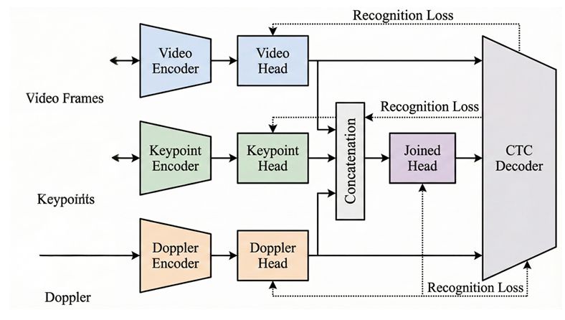
Methodology – The Multi-Stream Architecture
Three Parallel Streams:
Video (RGB): Captures texture and general context.
Keypoints (Structure): Uses 79 keypoints (Dsc-hrnet) converted to Gaussian heatmaps for fine-grained structure.
Doppler (Dynamics): Our novel stream for explicit motion modeling.
Notes:
We integrated this concept into a Multi-Stream Architecture. As you can see in the diagram, our model processes three parallel streams.
First, we have the Video Stream which handles standard RGB data to capture texture and context. Second, we have the Keypoint Stream, which extracts structural details using 79 body keypoints. And finally, the Doppler Stream, which explicitly models the dynamics of the gesture.
Crucially, these streams are processed independently before being fused at a late stage. This ensures that the network learns complementary features—texture, structure, and movement—without interfering with each other.

Slide 5
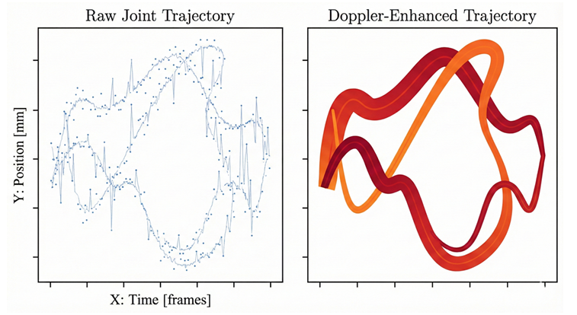
Why "Doppler" is Better than Optical Flow
Computational Complexity:
Optical Flow: Solves complex optimization equations.
Doppler Stream: Simple O(1) operation per pixel.
Visualizing the Difference:
Raw Trajectory: Noisy, micro-jitters.
Doppler-Enhanced: Emphasizes directional flow and filters noise.
Notes:
A key question is: Why choose our Doppler method over traditional Optical Flow? The answer lies in complexity and clarity.
Optical Flow is expensive because it requires solving complex optimization equations for every pixel. Our Doppler stream, by contrast, is a simple O(1) operation—it is instant.
You can see the difference visually in the trajectories on this slide. The 'Raw Joint Trajectory' on the left is often noisy and full of micro-jitters. The 'Doppler-Enhanced Trajectory' on the right is smooth and clearly emphasizes the directional flow of the sign. It filters out the noise and leaves us with pure motion data.

Slide 6
Experimental Results
Method | Dataset | WER (%)
Spatio-Temporal Aditya et al (2022) | PHOENIX 2014 | 21.5
PMTSN Chen et al (2022) | PHOENIX 2014 | 21.2
S.E. Zhu et al (2023) | PHOENIX 2014 | 20.9
C²SLR Zuo et al (2022) | PHOENIX 2014T | 20.4
SEN Hu et al (2023) | PHOENIX 2014T | 21.0
Consistency Zuo et al (2024) | PHOENIX 2014T | 20.4
SignGraph Gan et al (2024) | PHOENIX 2014T | 20.1
SlowFast Ahn et al (2024) | PHOENIX 2014T | 18.3
Baseline (Video + Keypoint) | PHOENIX 2014T | 18.35
+ Doppler Stream (Ours) | PHOENIX 2014T | 18.05
Method | Dataset | WER (%)
SubUNets Cihan Camgoz et al (2017) | CSL-Daily | 41.0
FCN Cheng et al (2020) | CSL-Daily | 33.5
Joint-SLRT Camgoz et al (2020) | CSL-Daily | 32.0
SignBT Zhou et al (2021) | CSL-Daily | 33.2
CorrNet Hu et al (2023) | CSL-Daily | 30.1
TwoStream-SLR Chen et al (2022) | CSL-Daily | 25.3
CTCA Guo et al (2023) | CSL-Daily | 29.4
AdaBrowse+ Hu et al (2023) | CSL-Daily | 30.7
Baseline (Video + Keypoint) | CSL-Daily | 25.8
+ Doppler Stream (Ours) | CSL-Daily | 24.9
Notes:
We evaluated our approach on the standard benchmarks, including Phoenix-2014 and CSL-Daily.
As you can see in the table, our method achieves a Word Error Rate of 18.05% on the Phoenix dataset. This result outperforms not only the baselines but also recent state-of-the-art models like the ICASSP 2024 entry.
Our ablation study confirmed that adding the Doppler stream was the decisive factor, dropping the error rate significantly compared to using just Video and Keypoints.

Slide 7
Efficiency & Robustness
Efficiency (The "Big" Win):
Model Size: Only 74 MB.
GFLOPs: 120.0 GFLOPs (vs. 521.3 for ICASSP '24).
Reduction: 77% reduction in computational cost.
Robustness (Edge Cases)
Rapid Gestures: 20.7% WER (vs. 21.0% Baseline).
Doppler turns "blur" into a signal strength proportional to velocity.
Notes:
However, the most significant result of this work is not just the accuracy, but the efficiency.
Our model size is only 74 MB. When we look at computational cost, we use only 120 GFLOPs, which is a 77% reduction compared to competitive models that require over 500 GFLOPs.
Furthermore, the model proved to be highly robust. In tests with 'Rapid' gestures—where motion blur typically causes models to fail—our Doppler stream actually performed better. This is because faster movement generates a stronger Doppler signal, helping the network track the hands even when they are moving too fast for the naked eye.

Slide 8
Conclusion & Future Work
Summary:
Proposed a Doppler Motion Stream for interpretable, efficient SLR.
Achieved SOTA (18.05% WER) with a lightweight footprint.
Future Directions:
Deploying on edge devices (mobile/tablets).
Integrating Doppler stream into Sign Language Translation (SLT) tasks.
Notes:
However, the most significant result of this work is not just the accuracy, but the efficiency.
Our model size is only 74 MB. When we look at computational cost, we use only 120 GFLOPs, which is a 77% reduction compared to competitive models that require over 500 GFLOPs.
Furthermore, the model proved to be highly robust. In tests with 'Rapid' gestures—where motion blur typically causes models to fail—our Doppler stream actually performed better. This is because faster movement generates a stronger Doppler signal, helping the network track the hands even when they are moving too fast for the naked eye.

Slide 9

THANK YOU
QUESTIONS?
Notes:
Thank you very much for your attention.
I have included a QR code to my LinkedIn here if you would like to connect or discuss this research further. I am now happy to take any questions you may have.

